Slide 1
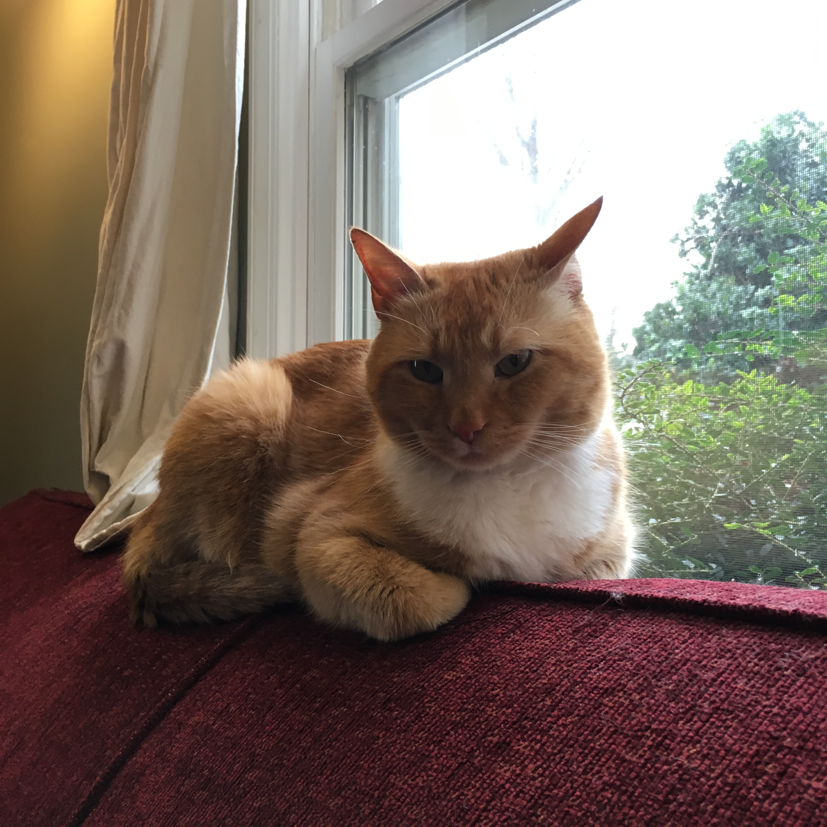

Slide 2


Slide 3
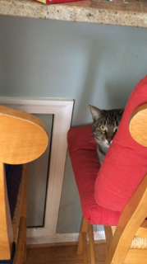
Introduction to Humanities Programming
Programming Concepts

Slide 4
I. Big questions we will cover:
Why do we use programming languages?
What are they?
Why one programming language (Python) over another?
II. Python basics we will cover:
Variables
Data types pt. 1: numbers and letters
Data types pt. 2: collections, lists, dictionaries
Methods and operators

Slide 5

What does it mean?

Slide 6

Why Program?
Applications come from the needs of the present: your needs
﻿Effectively articulating needs is the first step
Express complex logic and perform computation
Do things that would take a human a long time to do
counting
comparing
repeating

Slide 7
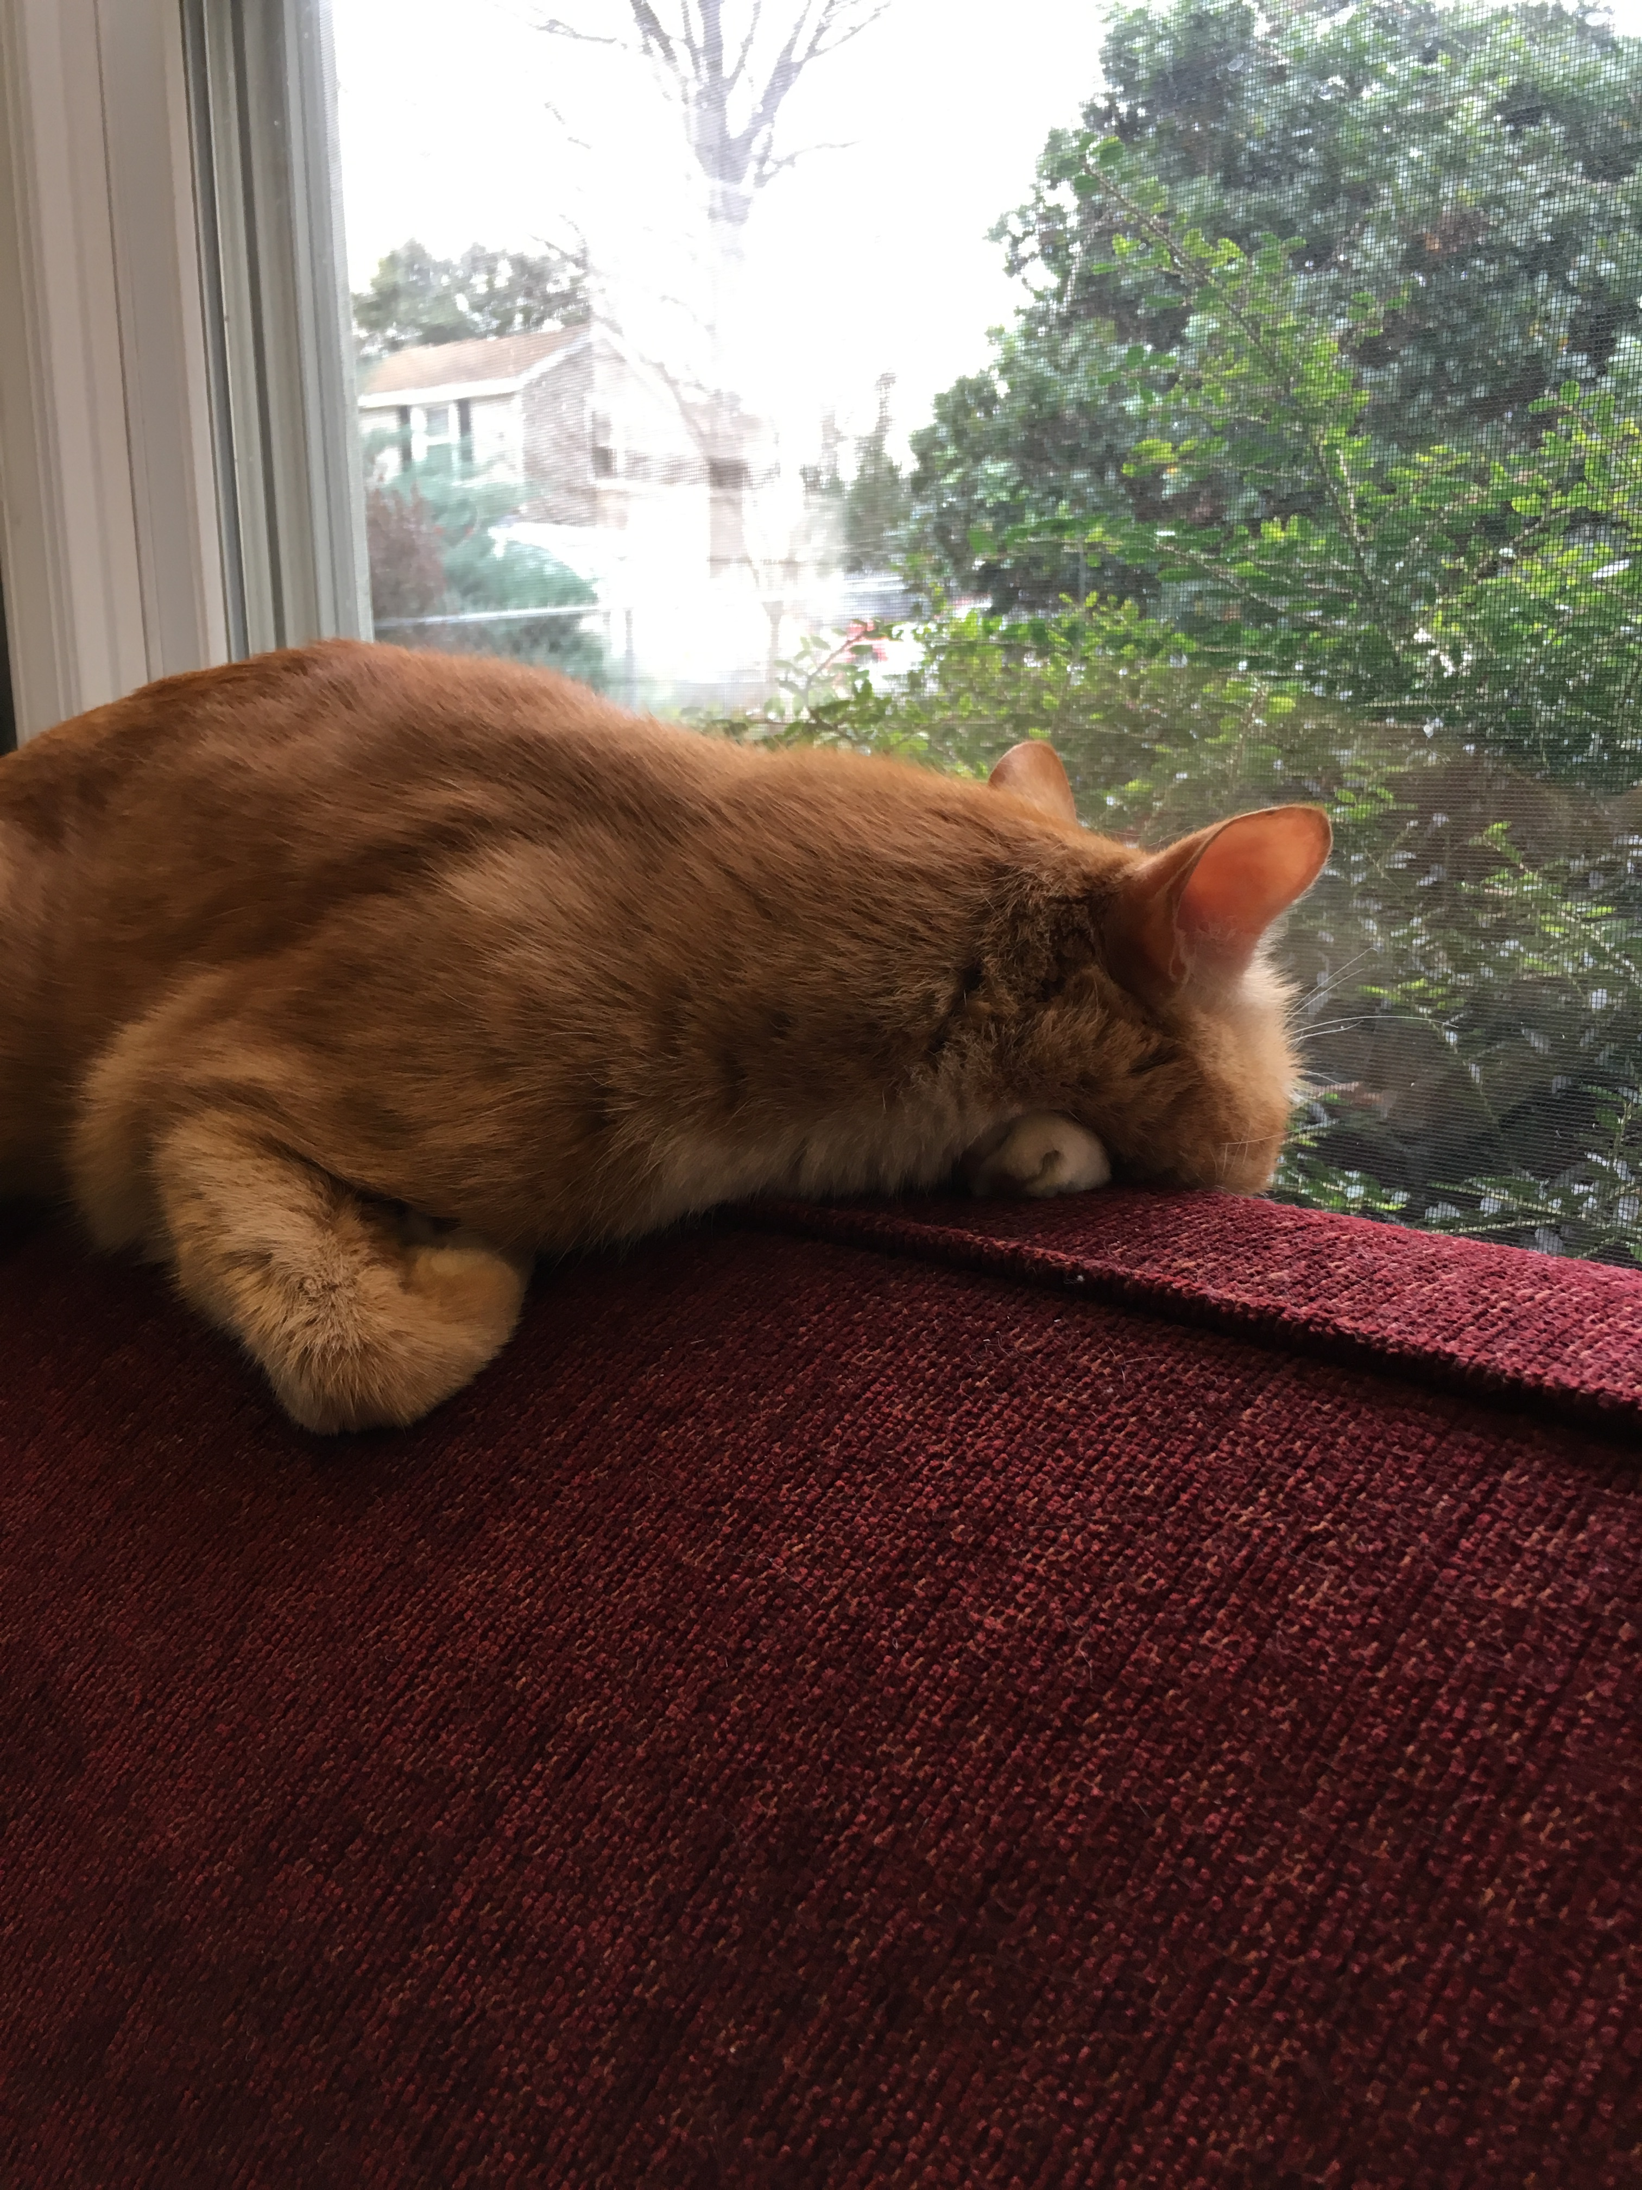
Digital Humanities Programming?
Notes:
What is it? How would they define it?

Slide 8
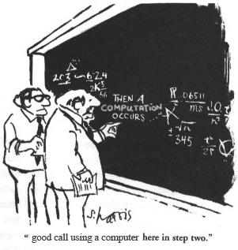
What is a programming language?
An artificial language with a limited purpose
A means of expressing computations (math) and algorithms (logic)

Slide 9
What is a programming language?
...like human languages in some ways!

Slide 10
Syntax (form)
Semantics (meaning)
signs/words (variables, symbols, numbers, strings)
expressions
"flow" (decisions, conditions, loops, narrative)
complex entities (methods, structures, & objects)

Slide 11
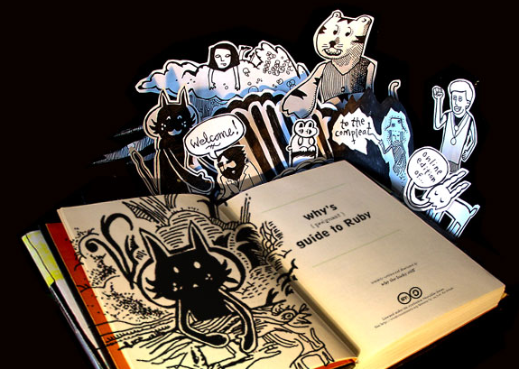
"when you don't create things, you become defined by your tastes rather than ability. your tastes only narrow & exclude people. so create.”
why the lucky stiff (@_why)
Notes:
Translation – get out there and try some stuff!

Slide 12
Language
Code used to create applications
Ruby
PHP
Python
JavaScript
Java
C++
C
many, many more...

Slide 13
Language Choice
Is it “easy” to maintain?
Is the standard library good enough?
What is it generally good for?
Can your team learn it?
Is your team using it?
Can you live with the syntax?
Do you hate it? Are you comfortable with it?

Slide 14
Library
A collection of reusable code to accomplish a generic activity
Date math (three months from today)
Logging
Working with file systems
Compressing files
Ex. - You don’t have to rewrite code to save a file to your drive each time because someone else did it for you!

Slide 15
Python
Python is a language
Libraries are called packages
Name is not a snake – it’s a Monty Python reference.
Notes:
Other things to add about it –
Syntax enforces good practices
Syntax matters
Good for doing things yourself
Flexible
legible
Difficult to manage installations sometimes

Slide 16
Python Philosophy:
Loaded into every Python installation as an easter egg:
>>> import this

Slide 17
Python Philosophy:
Beautiful is better than ugly.
Readability counts.
Errors should never pass silently. (JavaScript)
In the face of ambiguity, refuse the temptation to guess.
There should be one-- and preferably only one --obvious way to do it.
Now is better than never.

Slide 18
Why Python
General purpose
Usable on your computer or over the web
English-like syntax and useful built-in features
"Fun" to write
Syntax makes tabbing matter
Enforces good behaviors
Makes code very legible
Flexible
Implement things yourself
Good support
Notes:
Other things to add about it –
Syntax enforces good practices
Syntax matters
Good for doing things yourself
Flexible
legible
Difficult to manage installations sometimes

Slide 19
Why Not Python
Other languages can do some things better
R – better at stats and text analysis
Can do those things in Python, but might be slower or implementing from scratch
Difficult to manage package installations
Syntax matters
Forces you to have good behavior ☺
Not as easy to run on the web as PHP
Used less often than PHP, and major platforms (WordPress, Drupal, Omeka) use PHP
Notes:
Other things to add about it –
Syntax enforces good practices
Syntax matters
Good for doing things yourself
Flexible
legible
Difficult to manage installations sometimes

Slide 20
Two Pythons
Python 2.7
Python 3.3
Which to use? Complicated: 2 is more widely used, more third-party packages and not all port to 3.
3 is the present and future. Has better support for internationalization.
Mostly just need to know one the packages you’re using require. We’re using 3, but important to have both installed and know how to get between them.
Notes:
When programming, it’s not as easy as saying “oh we’ll just upgrade to the most recent version.

Slide 21
Two Pythons
Starting Python 2
$ python
Starting Python 3
$ python3
Might be reversed on your machine (High Sierra reversed them for me)
You can change this behavior – on my laptop I have those switched because I tend to use Python3 more.
Notes:
When programming, it’s not as easy as saying “oh we’ll just upgrade to the most recent version.

Slide 22
When Should I Program?
https://xkcd.com/1319/
Notes:
When programming, it’s not as easy as saying “oh we’ll just upgrade to the most recent version.

Slide 23
But!
In a DH context, it's not just about saving time.
Let's you do things you might not otherwise be able to do and think through questions that might have been unavailable.
We'll explore these topics a bit in the course as case studies…
Text analysis and visualization
Getting data from the DPLA API
Working with CSVs in a programmatic way
Notes:
When programming, it’s not as easy as saying “oh we’ll just upgrade to the most recent version.

Slide 24
I. Big questions we will cover:
Why do we use programming languages?
What are they?
Why one programming language (Python) over another?
II. Python basics we will cover:
Variables
Data types pt. 1: numbers and letters
Data types pt. 2: collections, lists, dictionaries
Methods and operators

Slide 25
What you will be able to do
create numeric and text information
store information in variables
print information to the screen

Slide 26
Open the Terminal
For us right now on VirtualBox:
Mint (Ubuntu): Terminal
Elsewhere:
Windows: git bash
OS X: iTerm2

Slide 27
Prompt
Terminals show a line of text after a command finishes
Whenever instructions start with "$ ", type the rest of the line into the terminal
Let's give the terminal a command to open Python 3.3 (python3)
$ python3
Notes:
A good point to pause and make sure it's all working

Slide 28
python3
Python has its own prompt that ends with >>>
$ python3
>>>
You can use Control + D to exit Python at any time or type exit() on its own line
When running Python in terminal, terminal commands won’t work

Slide 29
python3
You'll run Python from the command line, but you can't run command line commands once you're running Python. In other words…
$ python3
>>> cd
Traceback (most recent call last):
File "<stdin>", line 1, in <module>
NameError: name 'cd' is not defined

Slide 30
Variables
"words" that refer to information

Slide 31
Variables
Give it a name so we can refer to it
It's information can be changed
$ python3
>>> my_variable = 5
>>> print(my_variable)
5
>>> my_other_variable = "Hi"
>>> my_variable = 10
>>> my_other_variable
Hi
>>> my_variable
10
Notes:
What happened here?

Slide 32
What's with = ?
Setting a variable to a value is called "assignment"
What types of information can we hold in a variable?

Slide 33
Variable Assignment
Variables are assigned using a single equals sign (=)
The right side of the equals sign is evaluated first, then assigned to the variable name on the left side of the equals

Slide 34
Variable Assignment
apples = 5
bananas = 10 + 5
fruits = 2 + apples + bananas
bananas = fruits – apples
Try printing bananas, apples, and fruits to the terminal before and after!

Slide 35
Variable Naming
all letters (folders)
all numbers (2000)
with an underscore (first_name)
with a dash (last-name)
a number anywhere (l33t)
a number at the start (101dalmations)
a number at the end (starwars2)
Notes:
Alternates good and bad possibilities.
Why do we think that is?

Slide 36
Variable Naming
Be descriptive of the “thing”
Notes:
Words generally are better. Someone reading your code should be able to tell what you’re talking about

Slide 37
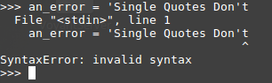
Errors
Notes:
Python tries to help you out

Slide 38
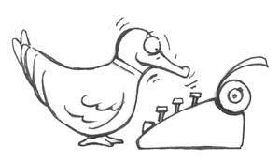
Python is a "duck-typed" language

Slide 39
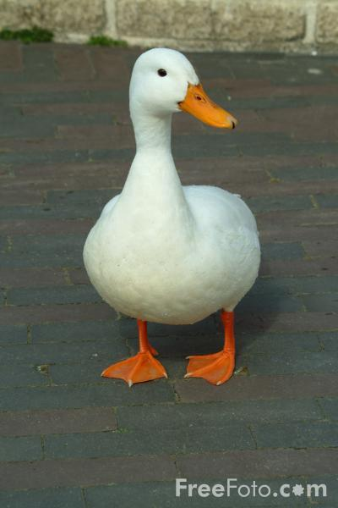
Duck-typing
If it looks like a duck and
it quacks like a duck,
chances are it's a duck.
Notes:
Means that the data types are not explicitly declared as such. We simply assume them to behave properly. And if they don’t they cause errors. So it’s a way of handling the declaration of variables.

Slide 40
Duck-typing
C:
int my_number = 3
vs
Python:
my_number = 3
Notes:
Means that the data types are not explicitly declared as such. We simply assume them to behave properly. And if they don’t they cause errors. So it’s a way of handling the declaration of variables.

Slide 41
Types of ducks
standard types:
numbers & letters
Notes:
characters and words (strings) sometimes two different things, depending on language

Slide 42
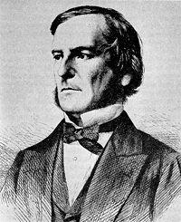
Numbers & Letters
integers:
4, 1040, -55, 9999
floating-point numbers:
1.1, 0.444, 9999.0001, -3.33
text (strings):
"a", 'cat', "The quick brown fox jumped over the lazy dogs.", '8 keys', '7'
boolean (yes or no?):
True, False, 0, 1
Notes:
characters and words (strings) sometimes two different things, depending on language

Slide 43
Strings
Strings are text; it must be wrapped in a matched pair of quotation marks.
$ python3
>>> 'Single quotes work'
'Single quotes work'
>>> "Double quotes work"
'Double quotes work'
>>> "Start and end have to match'
File "<stdin>”, line 1
"Start and end have to match'
^
SyntaxError: EOL while scanning string literal

Slide 44
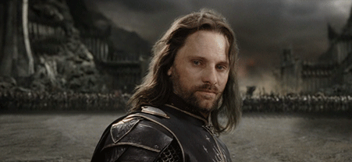
Exercise
Create variables named first_name, last_name, and favorite_color
Assign string values to the variables

Slide 45
Real-World Connection- What is a Text?
In computer terms, it's a big string.
You just have to process it.
Central question is how you take humanities concepts like "text" and convert them into data types legible to the computer.

Slide 46
Running Python
There are different ways to run code through Python
So far we used the Python interpreter
+ it's quick! Allows us to step through large problems step by
- no way to save your variables, classes, etc. Requires you to go through step by step.

Slide 47
Running code
Why use a file? What's different from running in the python interpreter?
Answer: you can save your progress and build up complicated projects.
Note: the directory your terminal is currently in is your working directory. You have to know where you are.

Slide 48
In Practice
You will very often switch back and forth between the interpreter and a persistent Python file.
This allows you to test while also building on your progress as you go.

Slide 49
Your Own Command Line Program

Slide 50
Hello World
Create a file named hello.py and add the following code to it using a text editor (Atom).
print("Hello, World!“)
Now run it (keep in mind you have to quit the Python interpreter to run this in the good old command line way)
$ python3 hello.py

Slide 51
Hello World 2
Test out another line of code in the interpreter by firing up python3.
print("Hi it's me again!")
Now add that line to your Python file. (you'll have to exit the interpreter). Save and run.
$ python3 hello.py

Slide 52
Hello World 2
The Python interpreter is its own world.
In fact, you can have multiple different tabs open in iTerm, each with their own Python instances running.
They won't know anything about one another – variable names and data only exist internal to a Python instance or file.
So if you run into problems, ask: am I where I need to be? Does Python know what I expect it to know?

Slide 53
A note on Filenames
You can't name a file just anything
"Python" is a collection of files itself, and these files have their own names on your computer.
These files have names, and they're often for common things. Like numbers. Numbers as a concept are defined in a file called numbers.py
If you make your own file called numbers.py, depending on how you run Python, it might try to import your numbers.py rather than its own, meaning it would forget what numbers are. And you'll get weird errors.
The important lesson here is don't name your python files stuff that is likely to already exist. Things like numbers.py, math.py, random.py, string.py, etc. Try to be more explicit about what your filenames are.

Slide 54
Git it?
Add your new Python program to your GitHub portfolio!
1. git add filename
2. git commit -m 'Snazzy message'
3. git push
4. add the link to your html page.
5. repeat the git steps for your index.html

Slide 55
From Now On
We will move back and forth b/w the interpreter and Python files.
Keep in mind that >>> means you're in the interpreter.
You'll need to switch back and forth between the two. I recommend keeping a Python interpreter open, a command line tab open, and a text editor open where you're writing files.
Many files are a good thing!

Slide 56
Numbers
Numbers without a decimal point are integers
0
-105
898989898
2
-898989898

Slide 57
Numbers
Numbers with decimal points are floating point numbers (floats)
0.0
-105.56
.33
.000004
3.14159265359

Slide 58
Numbers
You can perform operations on both types of numbers
+
-
/
*

Slide 59
Exercise (interpreter)
Try dividing an integer by an integer
Try dividing an integer by a float
Now do the same in Python 2.7
How are the results different?
Create two integer variables named num1 and num2 and assign your favorite numbers
Compute the sum, difference, quotient, and product of these two numbers and assign these values to variables named sum, difference, quotient, and product

Slide 60
An answer
num1 = 4
num2 = 5
sum = num1 + num2
difference = num1 - num2
quotient = num1 / num2
product = num1 * num2
If you try these in Python 2.7, why does quotient = 0 ?

Slide 61
Git it
Do the same work in a new file and save.
Add your new file to your growing portfolio!
Remember the steps?

Slide 62
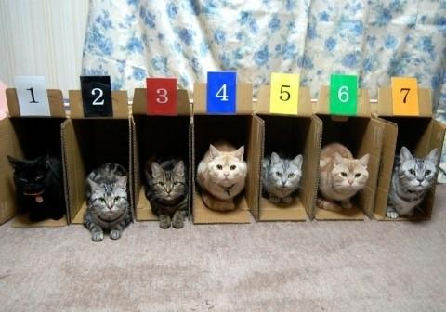
Collections
Notes:
Ways of organizing related groups of information to perform actions on them.

Slide 63
Collections
Collection Types: List, Dictionary
Define a list
List syntax
List indexing
List methods
Define a dict
Dict syntax
Dict indexing

Slide 64
List
A list is a collection of things
Each list is surrounded by square braces (aka square brackets) [ ]
Each item is separated by a comma
>>> fruits = ["kiwi", "strawberry", "plum"]
>>> fruits
['kiwi', 'strawberry', 'plum']
Notes:
>>> means interpreter right?

Slide 65
Exercise (in a file)
Make your own list named grocery_list
Include at least 5 items in your grocery list in the list

Slide 66
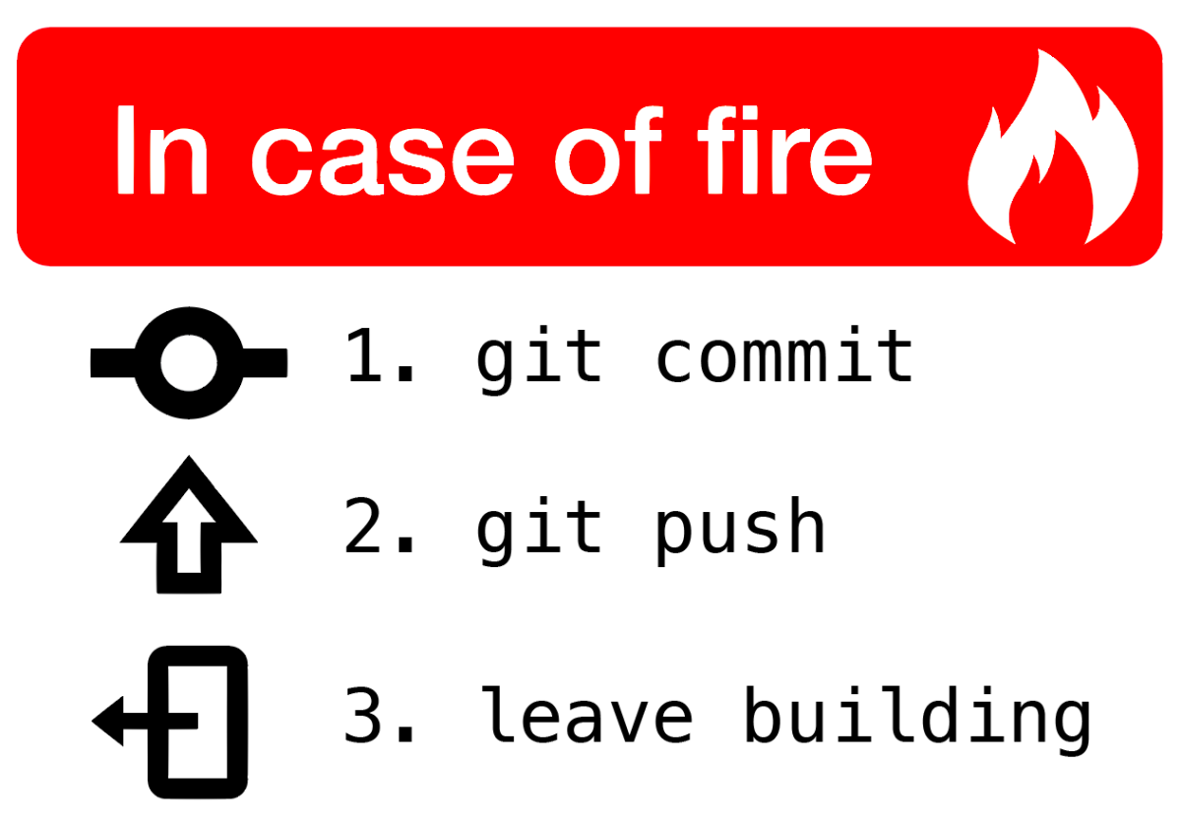
Notes:
Now let's get push again

Slide 67
List
Indexing
Items are stored in order
Each item can be accessed by its index
Python starts counting at zero
>>> fruits[0]
'kiwi'
>>> fruits[1]
'strawberry'
>>> fruits[2]
'plum'
Notes:
Why zero?
How many moves does it take to get to the next one.

Slide 68
Exercise
Still have your grocery_list list?
What is at index zero in your grocery list?
How about index 5?
Guess the answers and use the syntax examples to see if your guesses are correct
hint: fruits[0]

Slide 69
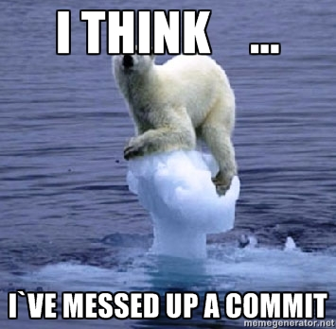

Slide 70
Dictionary
In a dict, we can associate an item with another value instead of just a number
Each item is a pair
Key: address of the dict member
Value: variable contained by the member, and located by the key name
Other names for a dictionary:
hash
associative array
Map
Items not stored in any order.

Slide 71
Dict Syntax
Surrounded by curly braces (aka curly brackets) { }
Commas separate each member pair
A key uses : (a colon) to point to its value
>>> states = {"VA": "Virginia", "MD": "Maryland"}
>>> states
{"VA": "Virginia", "MD“: "Maryland"}

Slide 72
Exercise
Define a dict named my_info that contains the following keys
first_name
last_name
hometown
favorite_food

Slide 73
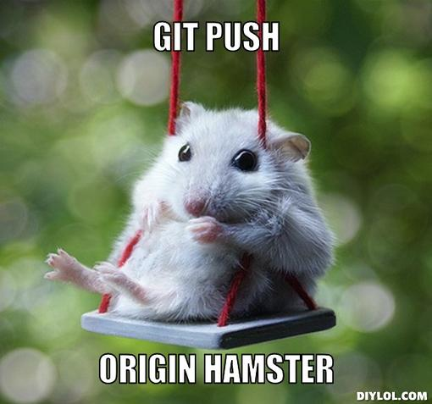
Notes:
Git push again!

Slide 74
Dict Indexing
Member pairs can be accessed by their key
Each key needs to be unique
Values do not need to be unique
Place key in brackets
>>> states["MD"]
'Maryland'

Slide 75
Add A Key
For lists:
>>> instructors = ["Brandon", "Ethan"]
>>> instructors.append("Tony")
For dictionaries:
>>> my_info["favorite_instructor"] = "Tony"

Slide 76
Exercise
Add the key good_food to your my_info dict and give it the same value as your favorite_food key. What happens?
Add a second favorite_food key to your my_info dict. What happens?
Notes:
if you had an error, check to make sure you have all the variables you expect in both your interpreter and your files.
Keys are overwritten if you use a new one. They have to be unique.
Values on the other hand don’t have to be unique. Multiple keys can have the same value.

Slide 77
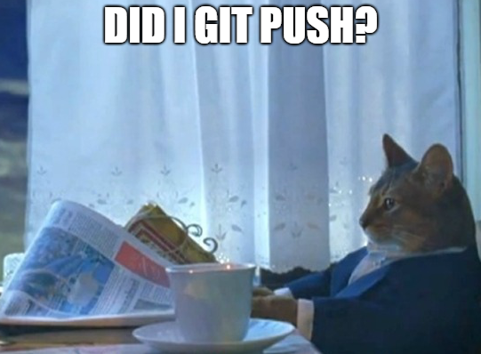

Slide 78
Methods
Things that do stuff
Objects (like strings, integers, and dictionaries) are nouns; methods are verbs
Called (used) with a "." or with method()
str(5) (str() is the method)
Each data type has a set of built in methods.
See String's methods https://docs.python.org/3/library/stdtypes.html#string-methods

Slide 79
Exercise
Create a String variable named old_string and assign it the value “Python is cool"
Use String methods to modify the old_string variable to that it is now “PYTHON IS COOL" and assign it to another variable named new_string
Hint: look at the String method "upper”

Slide 80
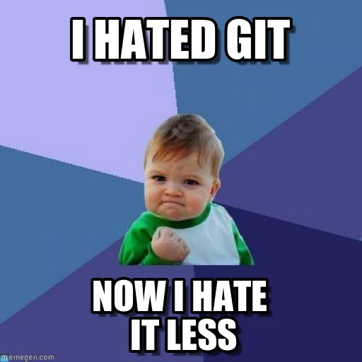

Slide 81
Booleans
A boolean can only have one of two values: True or False
>>> 1 + 1 == 2
True
>>> 1 + 1 == 0
False
(== means "is equal to;" More on that later...)

Slide 82
Exercise
Create a variable named favorite_color and assign it to your favorite color
Create a variable named not_favorite_color and assign it to a different color
Test if these variables are equal
Is equal to operator is ==

Slide 83
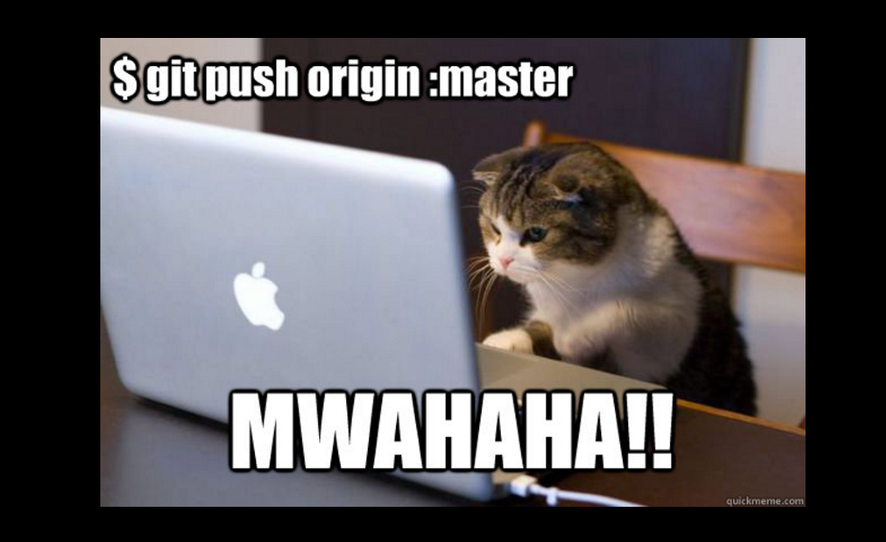

Slide 84
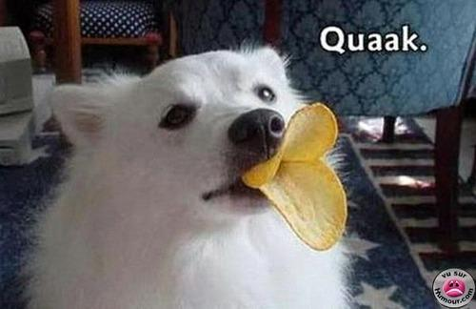
Sometimes there is a problem...
Notes:
With duck typed languages we assume that the variables we are using in particular places can do the things we want. Not always the case. Sometimes we need to change data types.

Slide 85
Sometimes there is a problem...
>>> "I am a string! Just going to add a number to this sentence now. " + 5
Traceback (most recent call last):
File "<stdin>", line 1, in <module>
TypeError: can only concatenate str (not "int") to str
Numbers can do number things.
Strings can do string things. How to move between them?
Notes:
With duck typed languages we assume that the variables we are using in particular places can do the things we want. Not always the case. Sometimes we need to change data types.

Slide 86
Casting to appropriate type
str(my_variable) (to string)
int(my_variable) (to integer)
float(my_variable) (float)
Example:
> float("3")
=> 3.0

Slide 87
Casting to appropriate type
>>> "I am a string! Just going to add a number to this sentence now. " + "5"
or
>>> "I am a string! Just going to add a number to this sentence now. " + str(5)

Slide 88
Operators: do stuff with objects
>>> my_variable + 2
7
>>> my_variable * 3
15
>>> my_other_variable + " there!" "hi there!"
>>> fruits = fruits + ["lychee"]
["kiwi", "strawberry", "plum", "lychee"]
>>> fruits.remove("lychee")
["kiwi", "strawberry", "plum"]
Notes:
"Doing stuff" usually doesn't change the variables used. You'd need to use write things like
new_variable = my_variable + 2
or
my_variable = my_variable + 2
to use this value later.

Slide 89
Exercises
Create a list named vegetables that contain three vegetables you like and one vegetable you don't
Using the vegetables list, create a list named my_vegetables that contains only the vegetables you like
Extra: can you use the first two lists to create a new list named your_vegetables that only contains the vegetables you don't like?
Notes:
Extra – your_vegetables = vegetables – my_vegetables

Slide 90
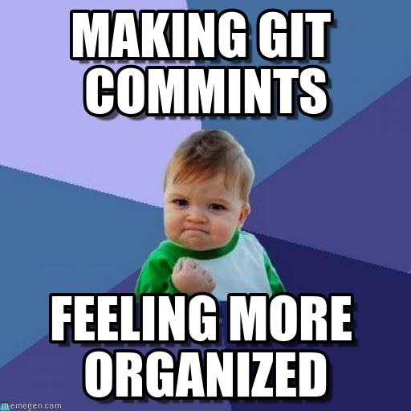

Slide 91
Spacing and Legibility
vegetables = ['here', 'are', 'my', 'vegetables']
Vs.
vegetables=['here’, 'are’,'my', 'vegetables']
Sometimes it matters and sometimes it does not. But it always affects readability. Keep things regular and neat.

Slide 92
More Operators
+, -, /, * math operators (+ also means concatenation)
= assign a value
+= addition, then assignment (x += y vs. x = x + y)
** exponent
== equal
!= not equal
For more operators: https://www.tutorialspoint.com/python/python_basic_operators.htm

Slide 93
Printing things to the screen
>>> print("Doctor Who")
>>> doctors = ['Matt Smith', 'David Tennent']
>>> print(doctors[0])
>>> best_episode = 'Blink'
>>> print("My favorite episode is " + best_episode)
>>> print("My favorite Doctor is " + doctors[1])

Slide 94
Code Exercise 1
Store your street address, city, state, and zip code in variables (or even better, a dictionary!), then print them in the usual format:
Brandon Walsh
123 My Street
Charlottesville, VA 22903

Slide 95
An Answer
address = {
'name': 'Ethan Reed',
'street': '123 My Street',
'city': 'Charlottesville',
'state': 'VA',
'zip': '22903'
}
print(address['name'])
print(address['street'])
print(address['city'] + ', ' + address['state'] + ' ' + address['zip'])
Notes:
Other options?

Slide 96
Code Exercise 1
A book you are interested in is 457 pages long, with an average of 250 words per page. If you were to break your book into 100 equal pieces, how many words would there be in each piece? Can you write code that is flexible enough to use for different lengths?
Bonus (conceptual, not coding): If you were to then take this information and use it, how would you go about taking that large book and breaking it into those equal pieces?

Slide 97
An Approach
Multiply the number of pages by the average number of words.
Do the math
Return a result
Use variables to make your work meaningful

Slide 98
An Answer
pages = 457
words_per_page = 250
number_of_pieces = 100
each_chunk = (457 * 250)/10
print(each_chunk)

Slide 99
Real World
Distributions of words across narrative time in 27,266 novels – David McClure
https://litlab.stanford.edu/distributions-of-words-27k-novels/

Slide 100
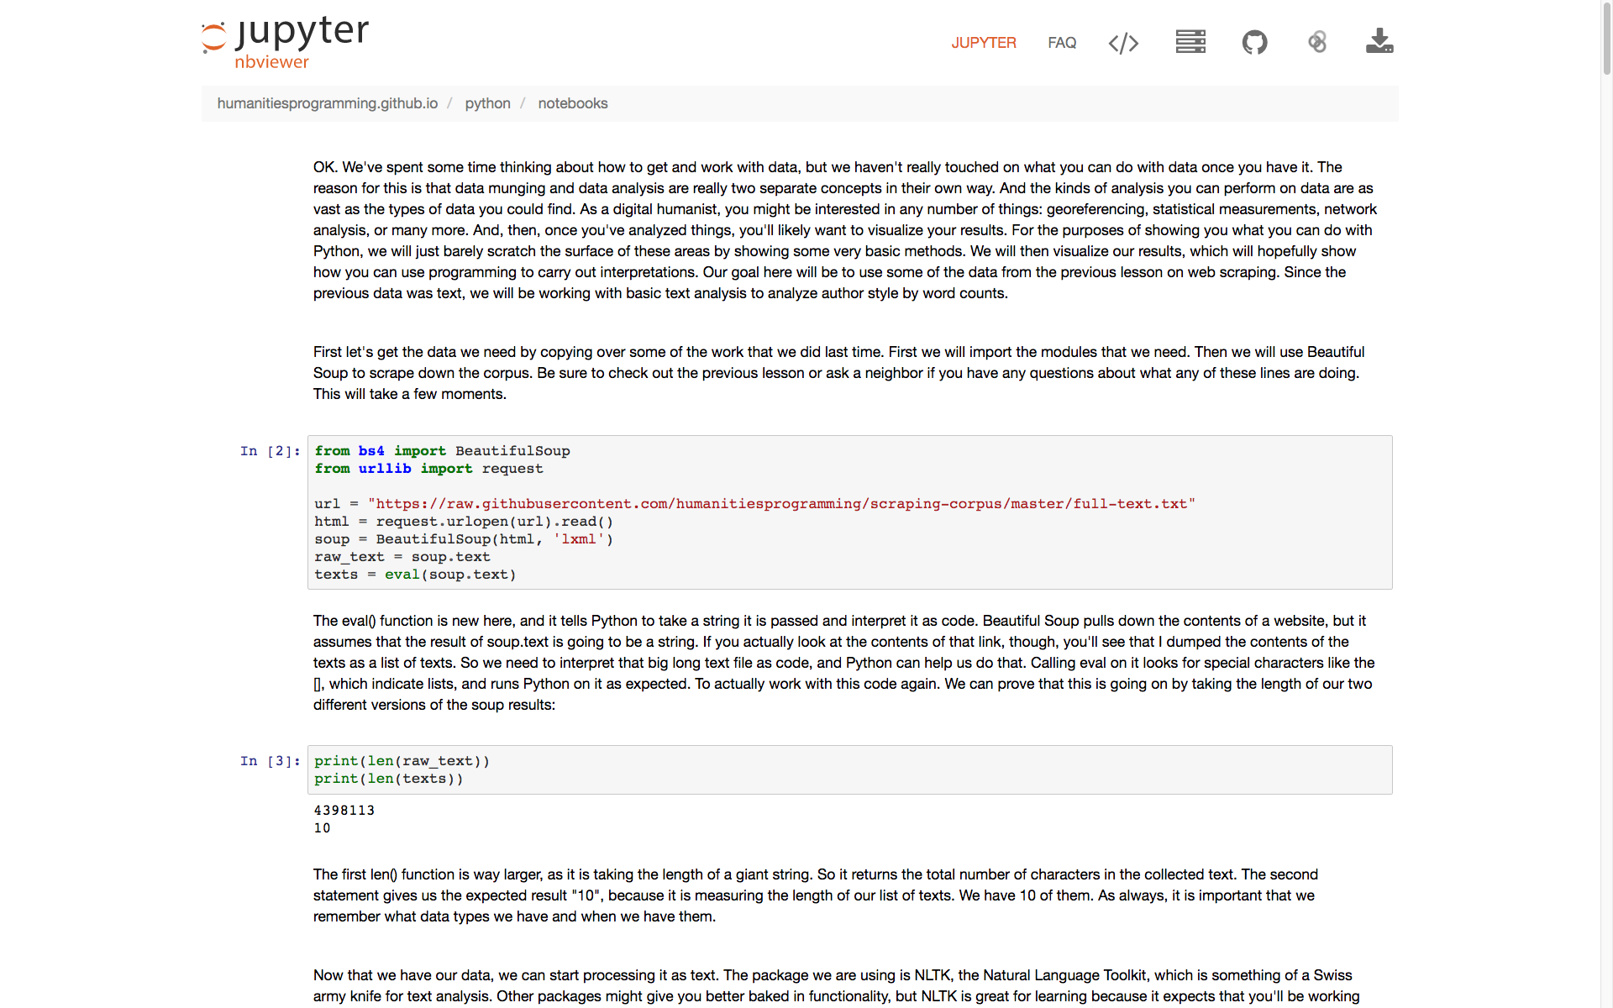
More immediate Real World
Notes:
When you get to the case studies, you'll be doing a lot of work with text analysis like this!
This is a basic problem of text analysis

Slide 101
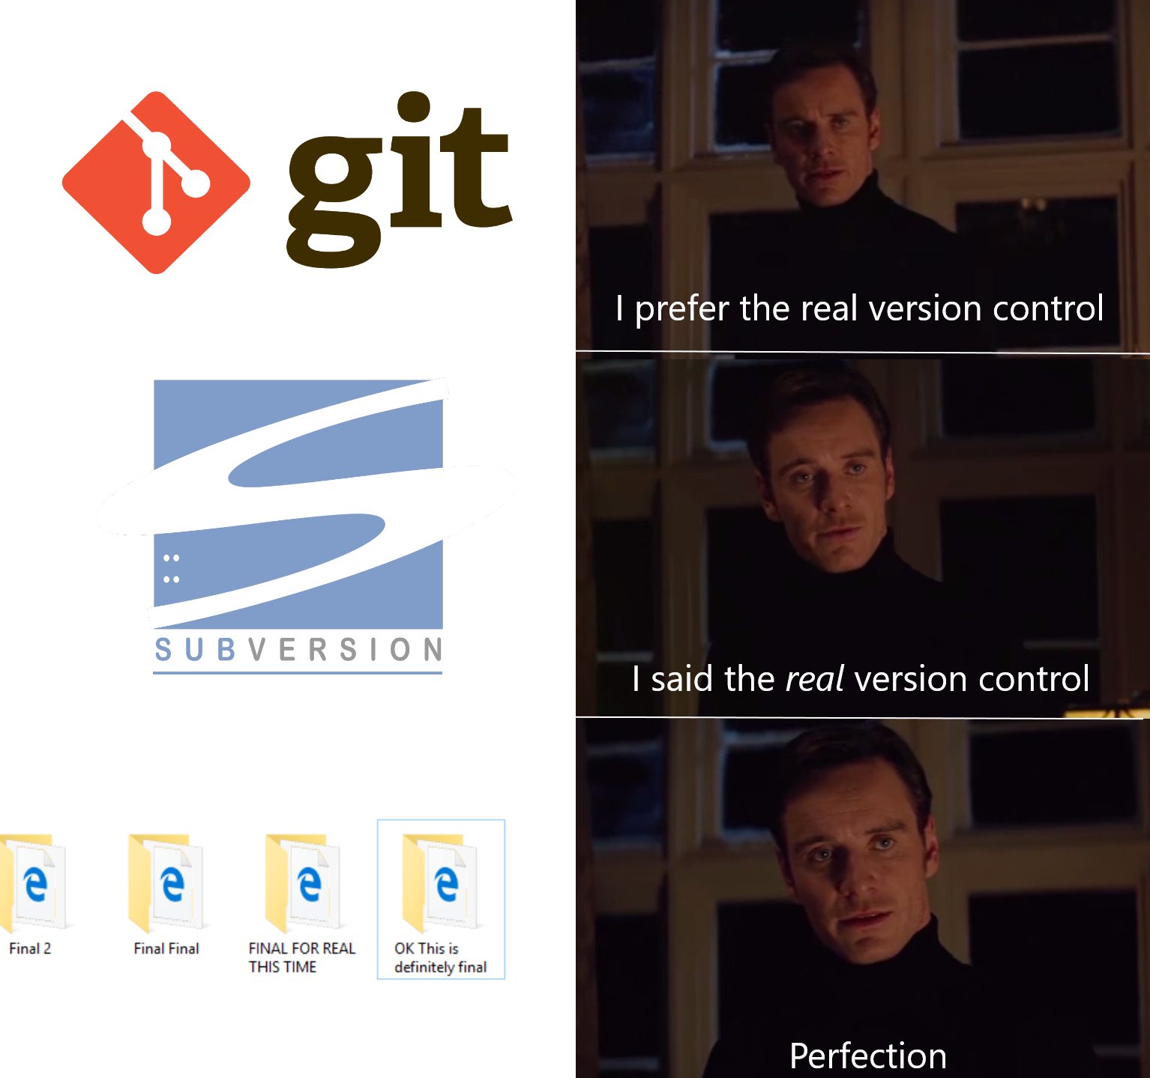

Slide 102
I. Big questions we totally covered today:
Why do we use programming languages?
What are they?
Why one programming language (Python) over another?
II. Python basics we also totally covered:
Variables
Data types pt. 1: numbers and letters
Data types pt. 2: collections, lists, dictionaries
Methods and operators

Slide 103
Resources
https://docs.python.org/3/
https://learnpythonthehardway.org/

